Slide 1
Braid Theory and Dynamics
Mitchell Berger
U Exeter

Slide 2
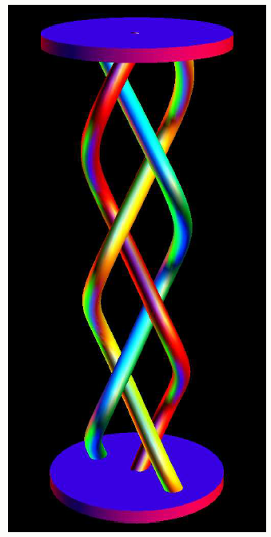
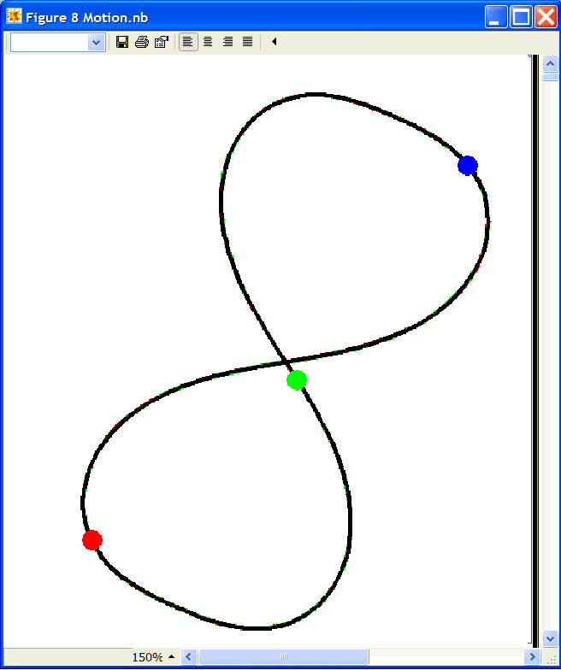
Given a history of motion of particles in a plane, we can construct a space-time diagram…
t

Slide 3
Applications
Analysis of One-Dimensional Dynamic Systems McRobie & Williams
Motion of Holes in a Magnetized Fluid Clausen, Helgeson, & Skjeltorp
Three Point Vortices Boyland, Aref, & Stremler
Choreographies Chanciner

Slide 4
Motion of Holes in a Magnetized Fluid Clausen, Helgeson, & Skjeltorp
Three Point Vortices Boyland, Aref, & Stremler
Choreographies Chanciner

Slide 5

Existence of Solutions
Given the equations of motion, which braid types exist as solutions?
Consider n-body motion in a plane with a potential
Then all braid types are possible for a ≤ -2 .
Moore 1992

Slide 6
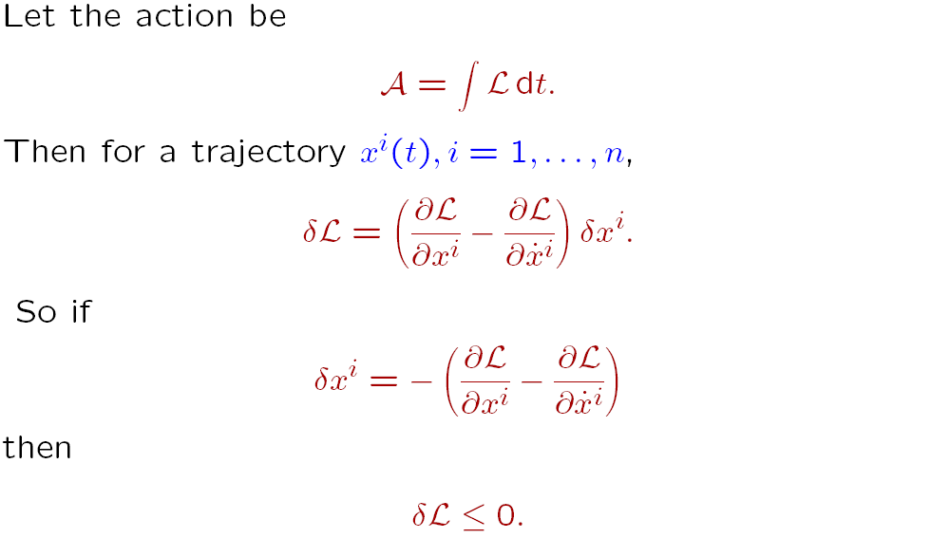
Moore’s Action Relaxation

Slide 7
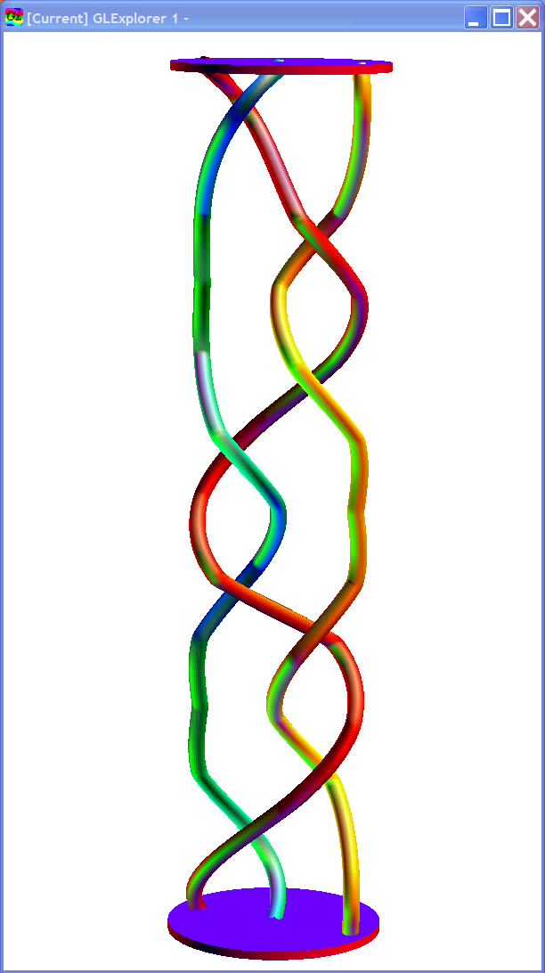

Relaxation to Minimum Energy State

Slide 8
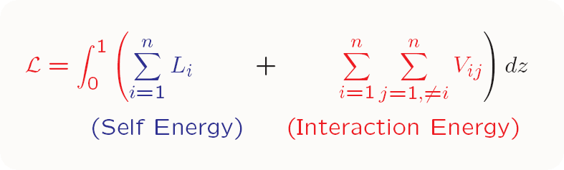
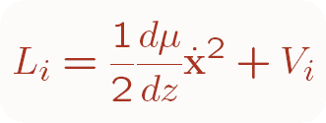
Self Energy of string i

Slide 9
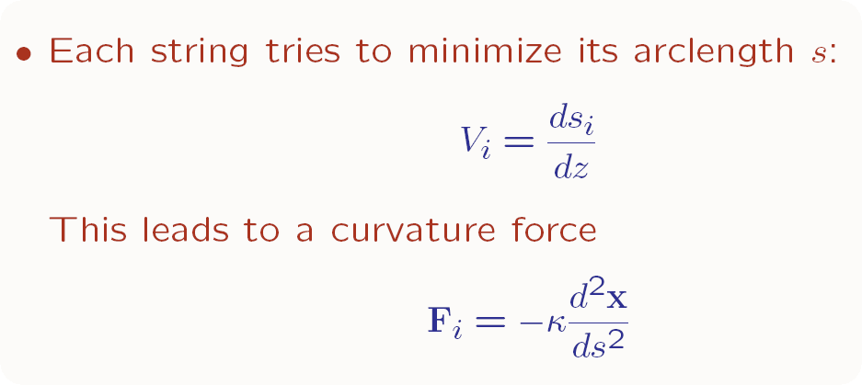
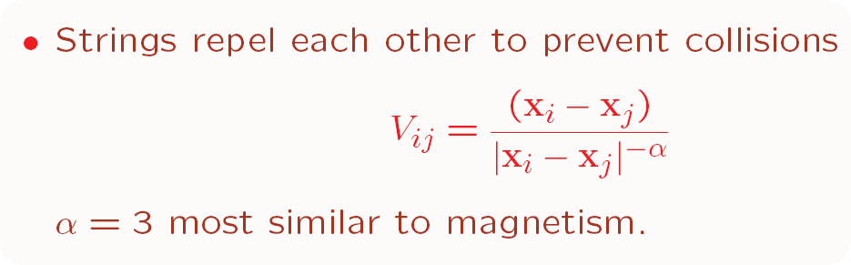

Slide 10
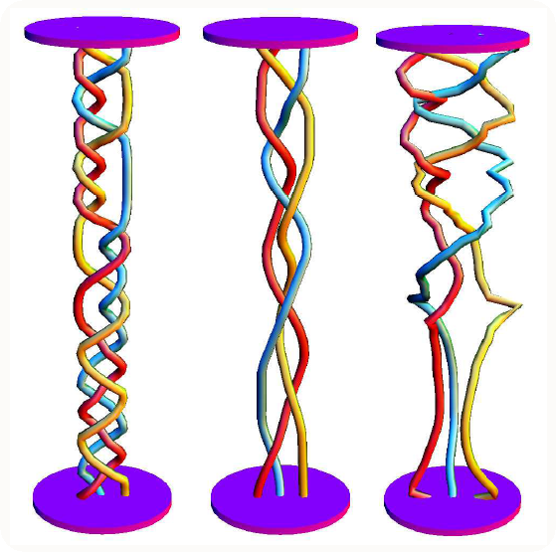

Slide 11
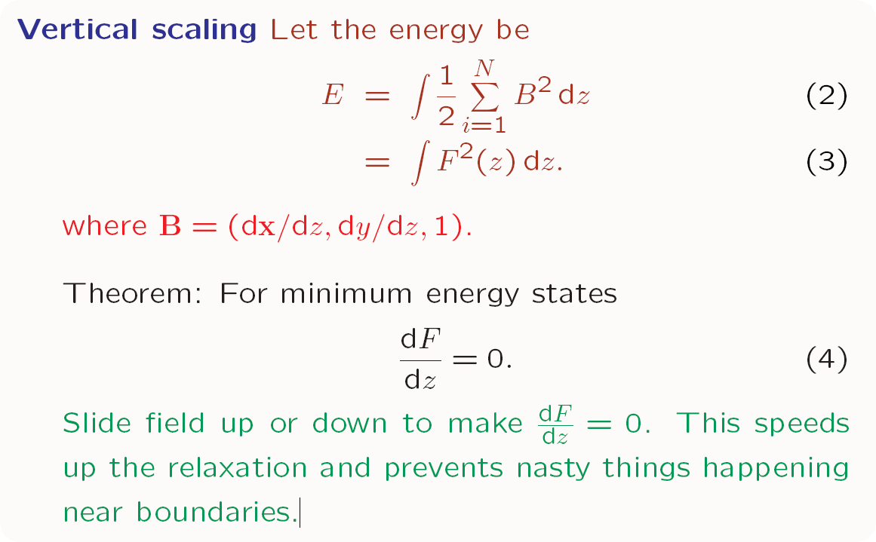

Slide 12
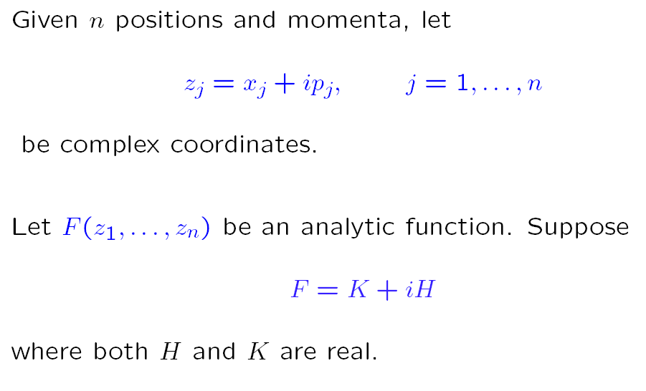
Complex Hamiltonians

Slide 13
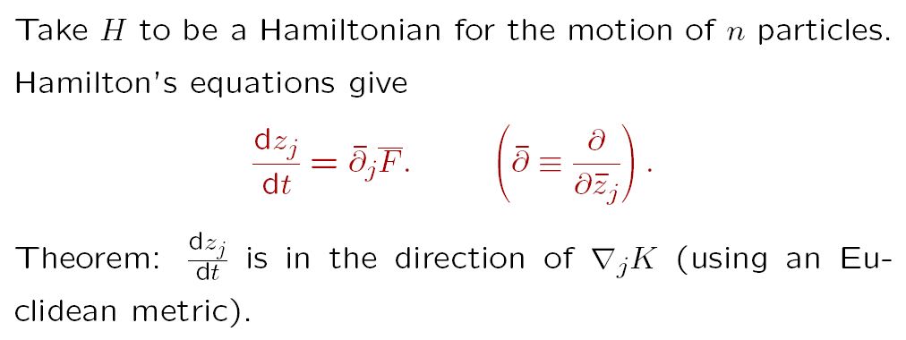

Slide 14
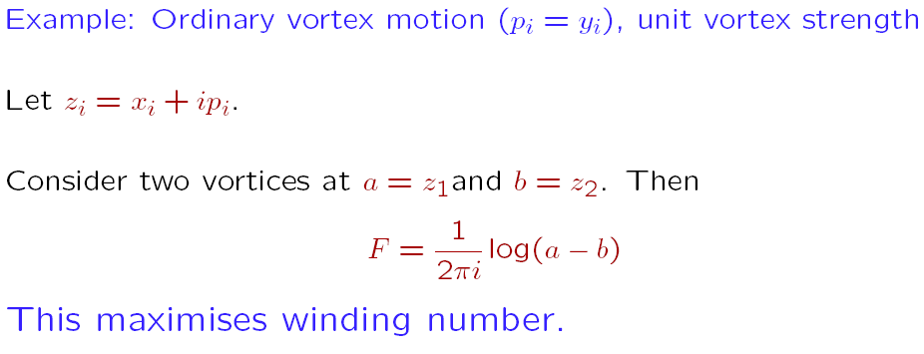
Two Point Vortices

Slide 15
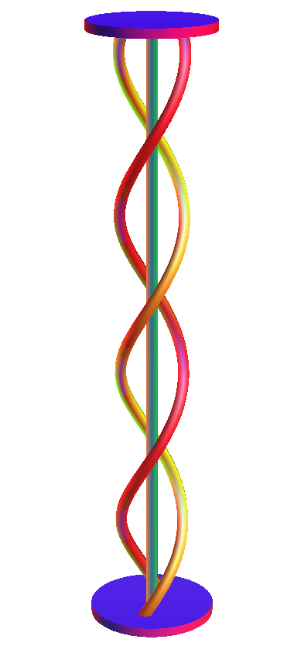
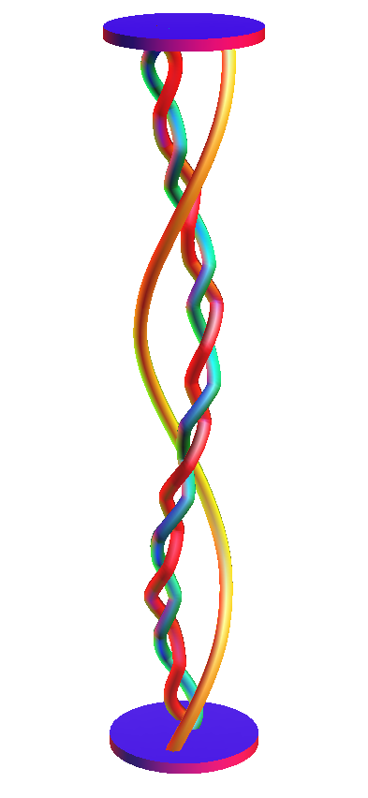
Uniform Vorticity

Slide 16
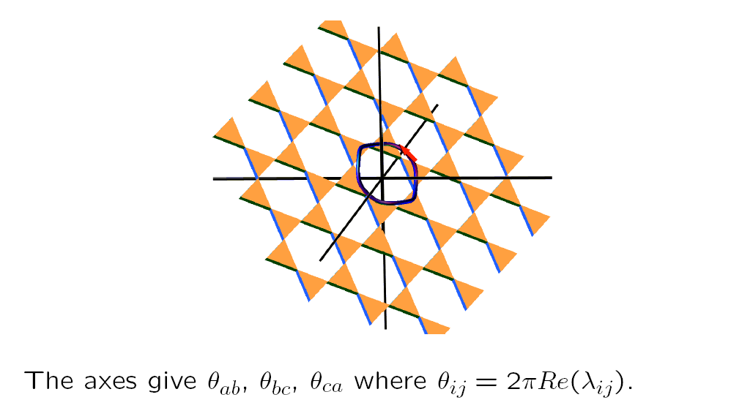
Winding Space

Slide 17
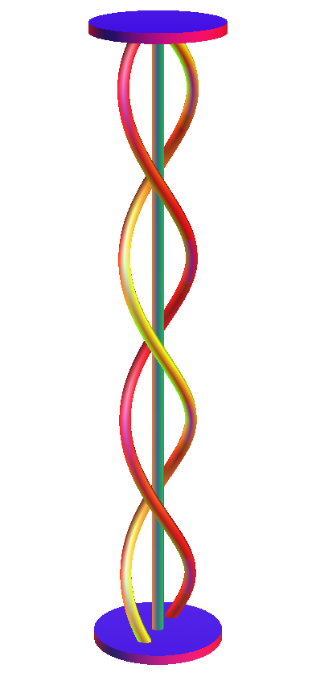
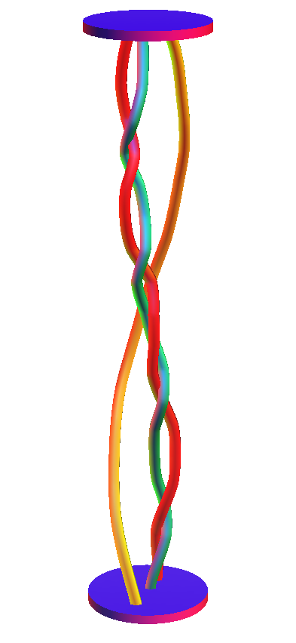
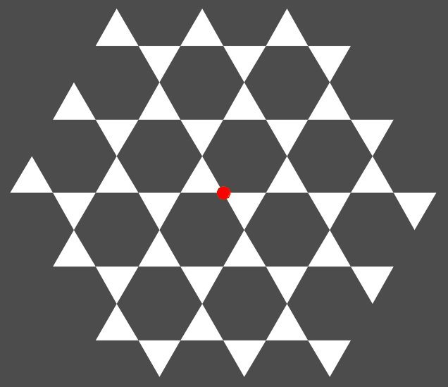
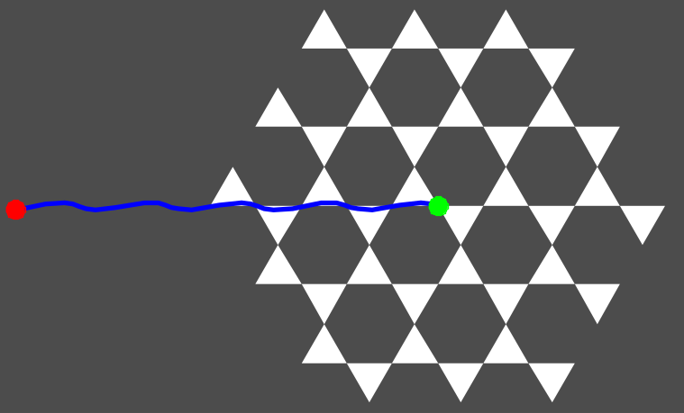
Zero Net Circulation

Slide 18
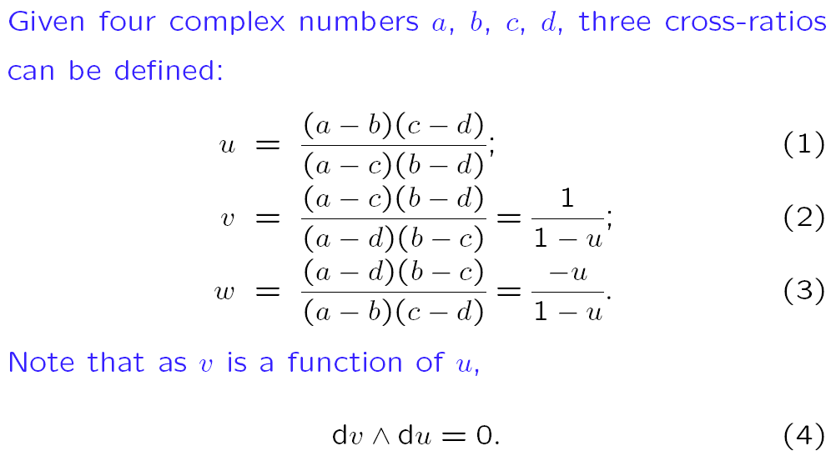
Cross Ratios

Slide 19
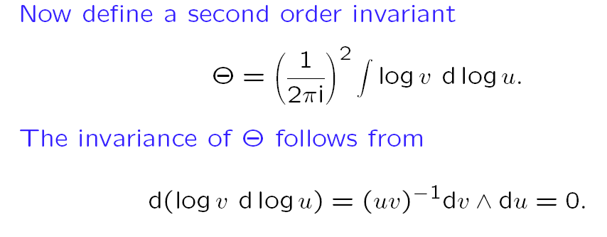
Second Order Invariants

Slide 20
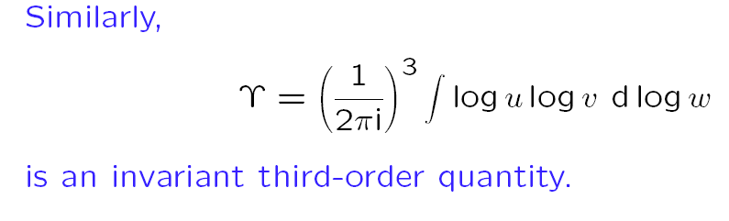
Third Order Invariants

Slide 21
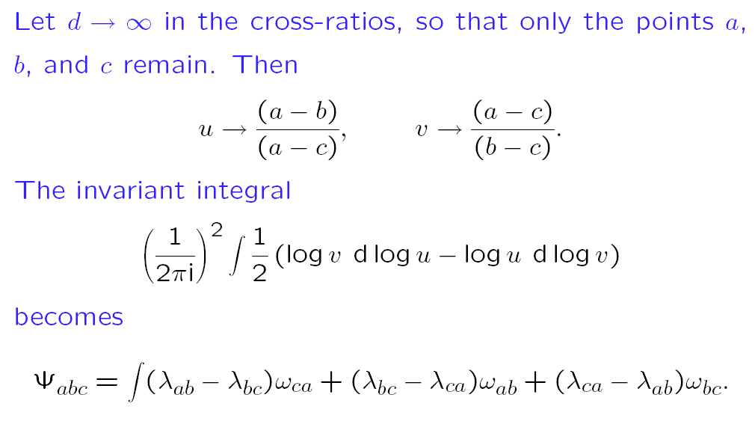
Cross ratios for three points

Slide 22
Integrability
Cross Ratios are symmetric to
Translations
Rotations
Scaling
Inversion
Noether’s theorem gives associated conserved
quantities, guaranteeing integrability

Slide 23
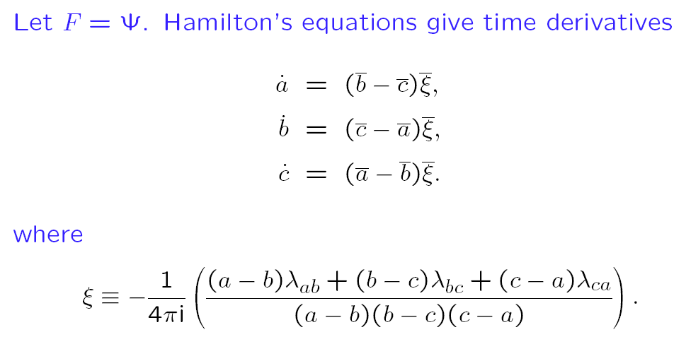
Hamiltonian Motion

Slide 24
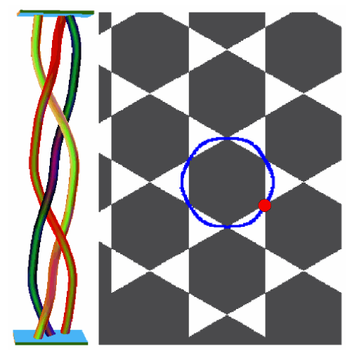
Pigtail Solution

Slide 25
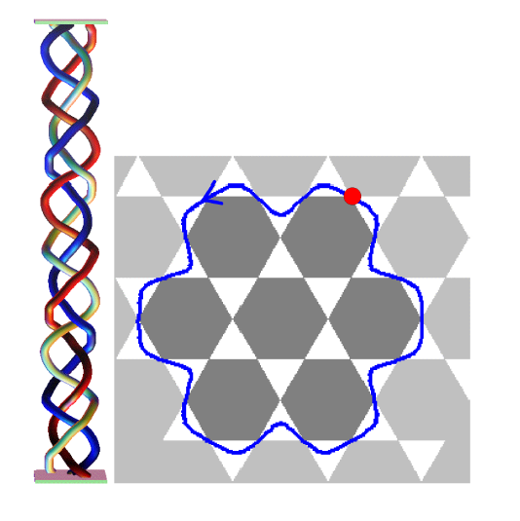
More Solutions

Slide 26
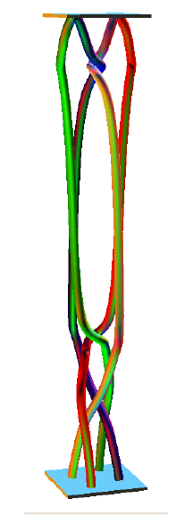
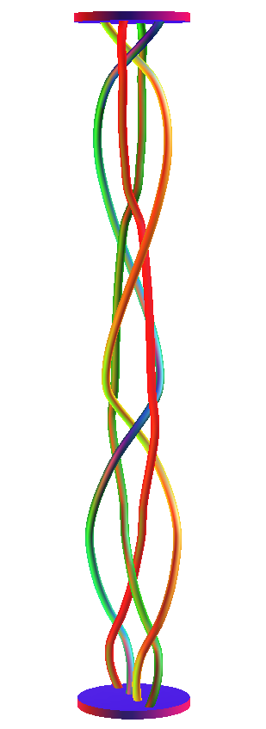
Third order (four point) motion

Slide 27
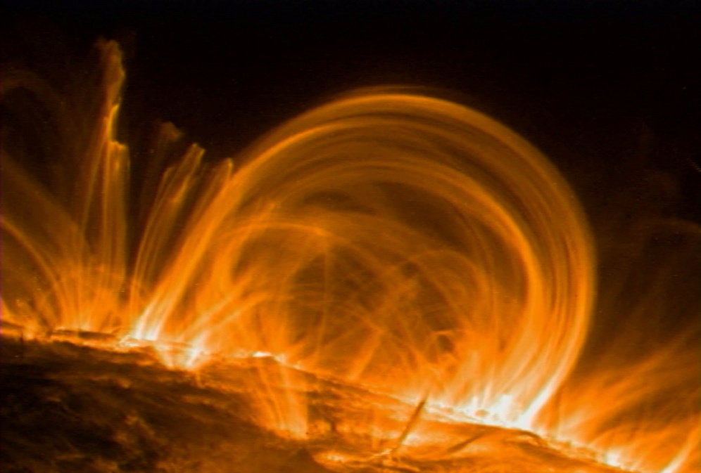
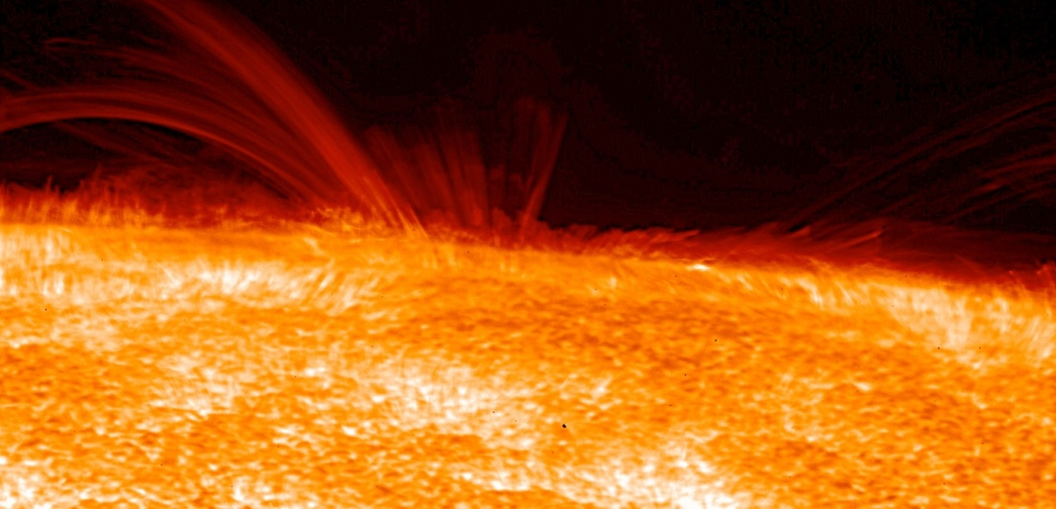
Coronal Heating and Nanoflares
Trace image
Hinode EIS (Extreme Ultra Violet Imaging spectrometer) image

Slide 28
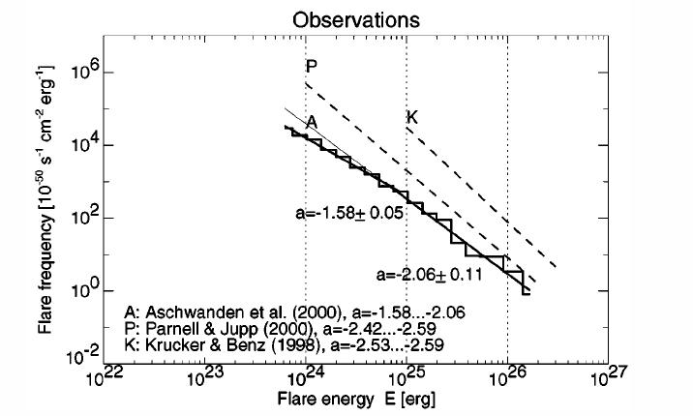
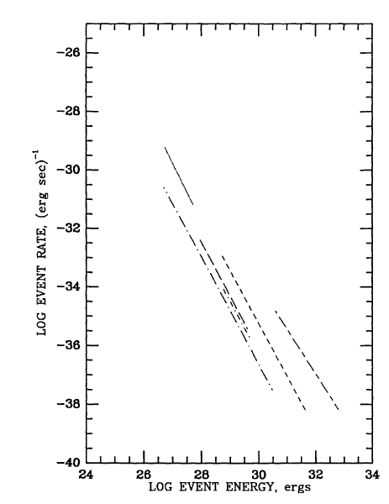
Why is the corona heated to 1 − 2 million degrees?
What causes flares, µflares, and νflares? Why do they have a power law energy distribution?
Hudson 1993

Slide 29
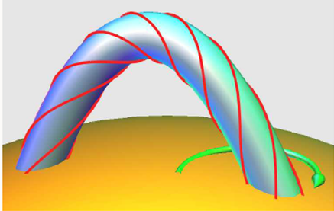
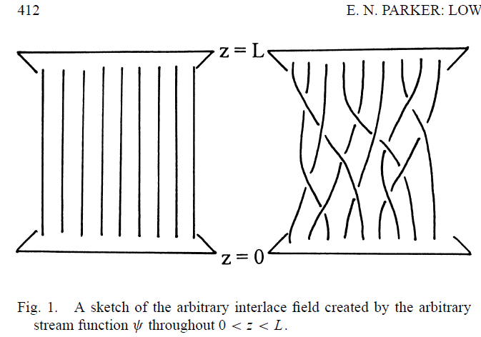
Sturrock-Uchida 1981
Parker 1983
Random twisting of one tube
Energy is quadratic in twist, but mean square twist grows only linearly in time.
Power = dE/dt independent of saturation time.
Braiding of many tubes
Energy grows as t² .
Power grows linearly with saturation time.
Twisting is faster, but braiding is more efficient!

Slide 30
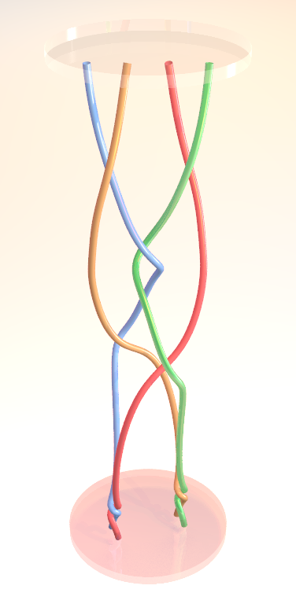
Classification of Braids
Periodic
(uniform twist)
reducible
Pseudo-Anosov
(anything else)
30

Slide 31
Braided Magnetic Fields
Braided Discrete Fields
  Well-defined flux loops may exist in the solar corona:
  The flux at the photosphere is highly localised
  Trace and Hinode pictures show discrete loops
Braided Continuous Fields
  Choose sets of field lines within the field; each set will exhibit a different amount of braiding Wilmot-Smith, Hornig, & Pontin 2009
  Coronal Loops split near their feet
  Reconnection will fragment the flux

Slide 32
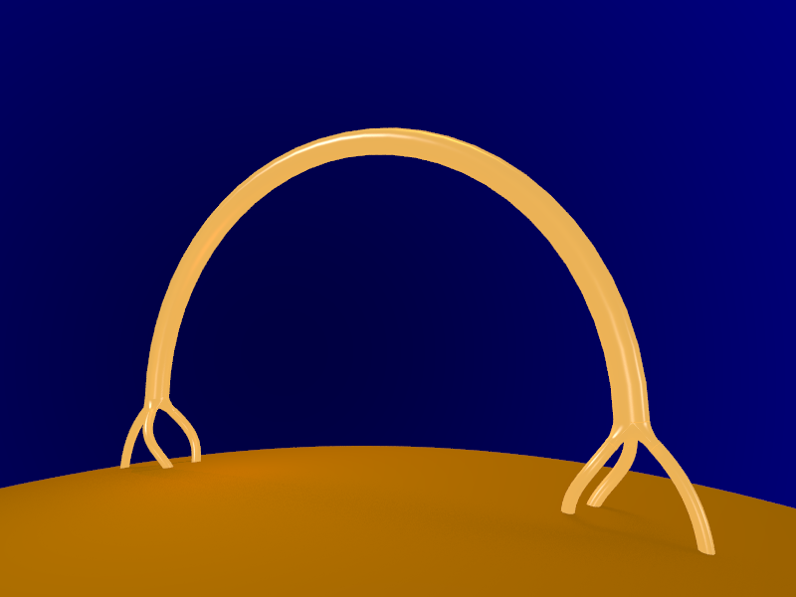
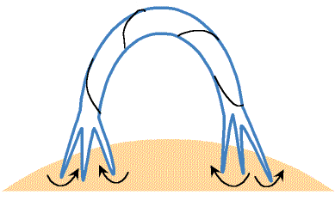
Flux Tube Splitting
More recent models add interactions with small low lying loops Ruzmaikin & Berger 98, Schriver 01
Flux tube endpoints constantly split up and gather together again, but in new combinations. This locks positive twist away from negative twist. Berger 94

Slide 33
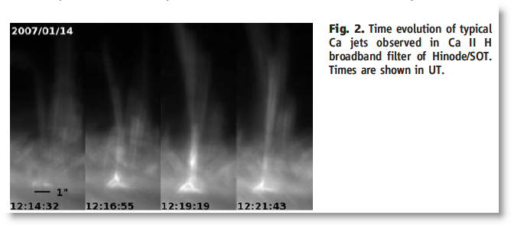
Shibata et al 2007 Hinode “Anemone jets”

Slide 34
Parker’s topological dissipation scenario:
Corona evolves quasi-statically due to footpoint motions (Alfvén travel time 10-100 secs for loop, photospheric motion timescale ~2000 seconds)
Smooth equilibria scarce or nonexistent for non-trivial topologies – current sheets must form
Slow burn while stresses buildup
Eventually something triggers fast reconnection

Slide 35
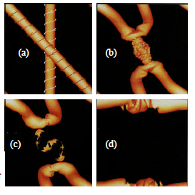
Reconnection
Klimchuck and co.: Secondary Instabilities
When neighbouring tubes are misaligned by ~ 30 degrees, a fast reconnection may be triggered. This removes a crossing, releasing magnetic energy into heat – a nanoflare.
Linton, Dahlburg and Antiochos 2001
Dahlburg, Klimchuck & Antiochos 2005

Slide 36
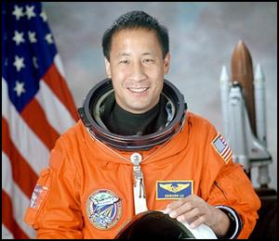
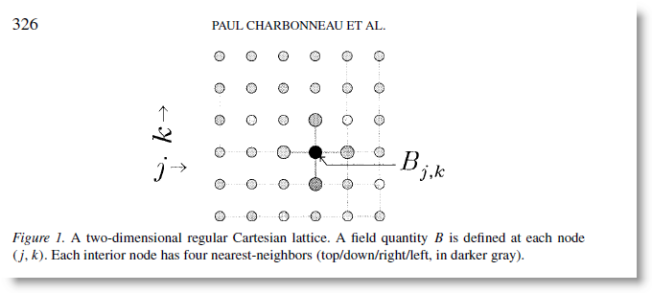
Avalanche Models
Introduced by Lu and Hamilton (1991)
Bits of energy are added randomly to nodes on a grid. When field energy or gradients exceed a threshold, a node shares its excess with its neighbours.
Ed Lu
This triggers more events. Eventually a self-organized critical state emerges with structure on all length scales. Total avalanche energies, peak power output, and duration of avalanches all follow power laws.

Slide 37

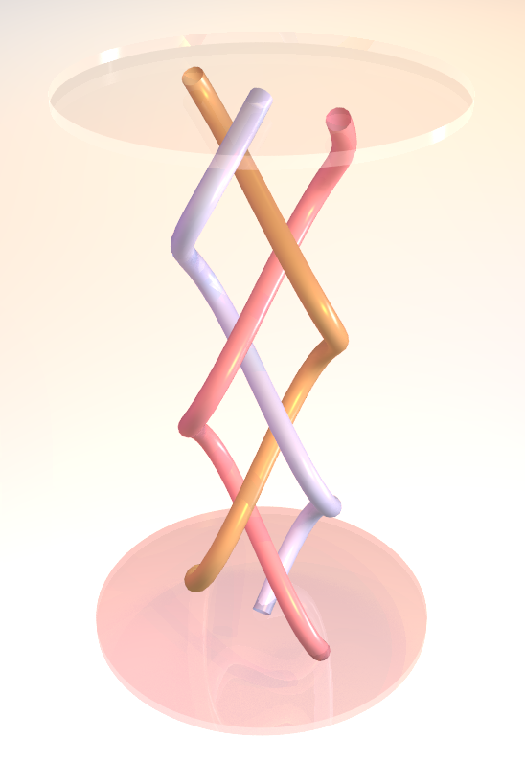
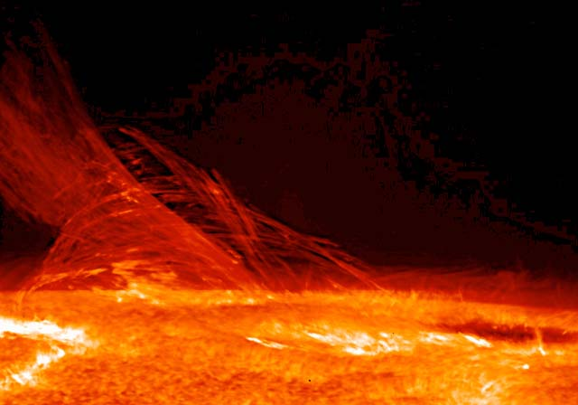
Will we be able to see braids on the sun?

Slide 38
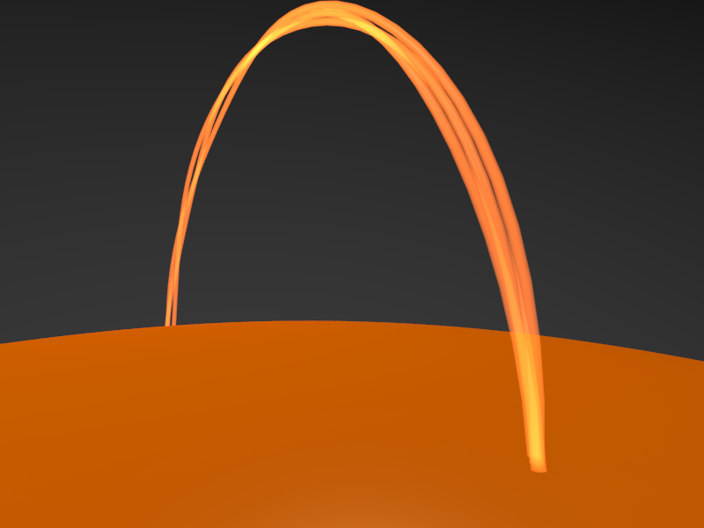

15 February 2008

Slide 39
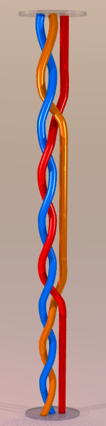
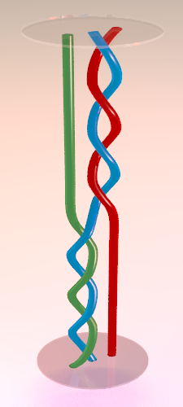
Braids with some amount of coherence

Slide 40
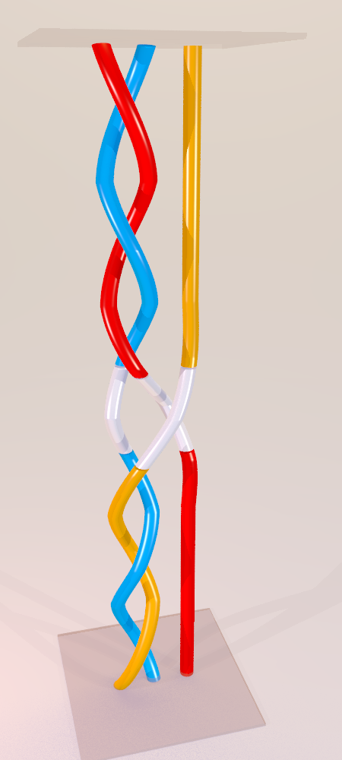
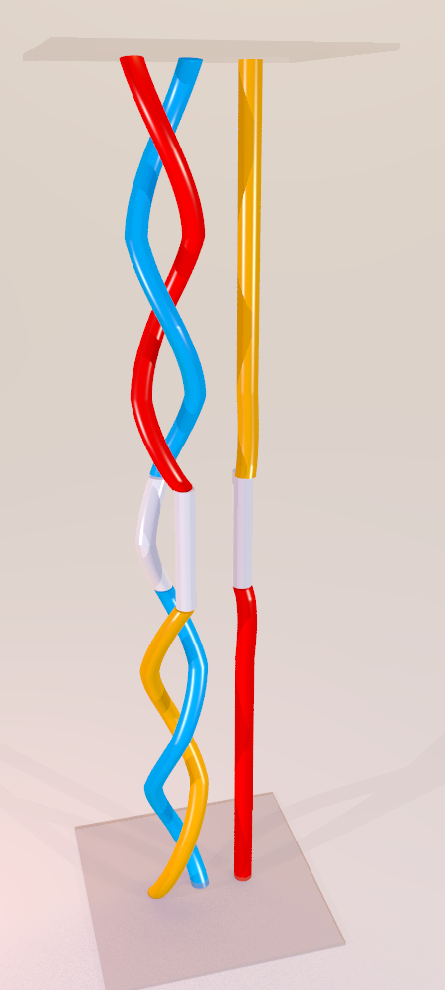
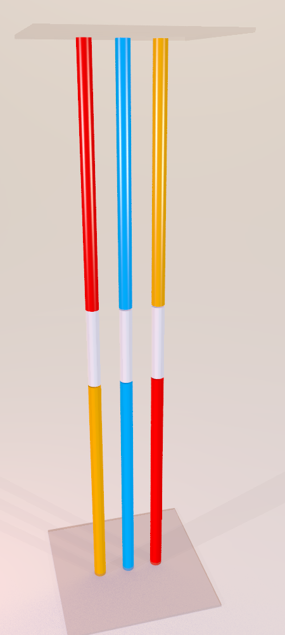

Reconnection in a coherent braid can release a large amount of energy…

Slide 41
Example with complete cancellation

Slide 42
A simple model for producing coherent braids
coherent section
(w = 2)
At each time step:
Create one new “coherent section
Remove one randomly chosen interchange. The neighbouring sections merge.
interchange
coherent section
(w = 4)
interchange
coherent section
(w = 3)
What is the steady state probability distribution f(w) of coherent sections with twist w?
42

Slide 43

Analysis
Let p(w) be the probability that the new coherent section has length w. Then at each time step,
(Take negative square root for good behaviour at infinity).

Slide 44




Input as a Poisson process:
Solution:
where L₋₁ is a Struve L function, and I₁ is a Bessel I function.
Asymptotic Power law
with slope α = -2.
Flare energies should
be a power law with slope 2 α +1 = -3.

Slide 45


Monte Carlo simulation – no boundaries
Slope = -2.01
Slope = -3.15
Coherent sequence sizes
Energy releases
Periodic boundary, nsequences = 100, nflares = 16000, nruns = 4000

Slide 46


With input only at boundaries
Slope = -2.90
Slope = -3.03
Coherent sequence sizes
Energy releases
Fixed boundary, nsequences = 100, nflares = 4000, nruns = 1000

Slide 47


Flares near loop ends
Flares near loop middle

Slide 48
Conclusions
Braiding of Trace or Hinode loops may not be obvious if the braid is highly coherent!
Selective reconnection leads to a self-organized braid pattern
Presence of boundaries in the model steepens sequence distribution, but not energy distribution
Model gives more, smaller flares near boundaries; a few big flares in the centre.
Without avalanches, the energy release slope is perhaps too high (3 – 3.5)

Slide 49

1. Mixing and Vortex Dynamics
Boyland, Aref and Stremler 2000: Mix a fluid with N paddles moving in a plane. The mixing efficiency can be determined from the braid pattern of the space-time diagram.

Slide 50
Topological Entropy
Essentially, if we repeat the stirring n times, the length of the line segment should increase as
e^{μ n}
where μ is the topological entropy.
From Boyland, Stremler, and Aref 2000

Slide 51



Topological Entropy from braid theory
Method:
Assign to each crossing a matrix (called the Bureau matrix).
2. Multiply the matrices for all the crossings.
3. Extract the largest eigenvalue λ (the ‘braid factor’) λ = e^{μ}.
4. Take its log.

Slide 52




Example: a pigtail braid
Braid factor =

